Slide 1
OPERATION ANALYTICS AND INVESTIGATING METRIC SPIKE
PRINCE KUMAR
EMAIL - prince22495@gmail.com

Slide 2
OUTLINE
Project Description
Approach
Tech-Stack Used
Operation Insights
Result

Slide 3
PROJECT DESCRIPTION
In this Operation Analytics project, I, as a Data Analyst Lead at a company like Microsoft, will conduct a thorough analysis of the company's end-to-end operations. By collaborating closely with teams such as operations, support, and marketing, I will leverage their collected data to identify areas for improvement and provide valuable insights.
This analysis is crucial for predicting the company's overall growth or decline, leading to better automation, improved collaboration among cross-functional teams, and more efficient workflows.
A key component of operation analytics is investigating metric spikes. As a Data Analyst, I will diligently examine fluctuations in daily engagement, sales performance, and other important metrics, answering questions that arise on a daily basis.
In my role, I will work with diverse data sets and tables to extract insights and provide clear answers to inquiries from different departments. Utilizing my SQL skills and expertise, I will contribute to evidence-based decision-making and foster a deeper understanding of operational performance, ultimately contributing to the company's success.

Slide 4
PROJECT DESCRIPTION
Case Study 1: Job Data Analysis:
In this case, I will analyze the job data related trends on a job data table which consists of columns like job IDs, actor IDs, event, language, time spent, organization along with dates. I will be analyzing this data to find answers to questions related to Number of jobs reviewed, Throughput, Percentage share of each language and Duplicate rows.
Case Study 2: Investigating metric spike:
In this case, I will be dealing with three tables named as users, events and email_events to drive insights related to User Engagement, User Growth, Weekly Retention, Weekly Engagement and Email Engagement.

Slide 5
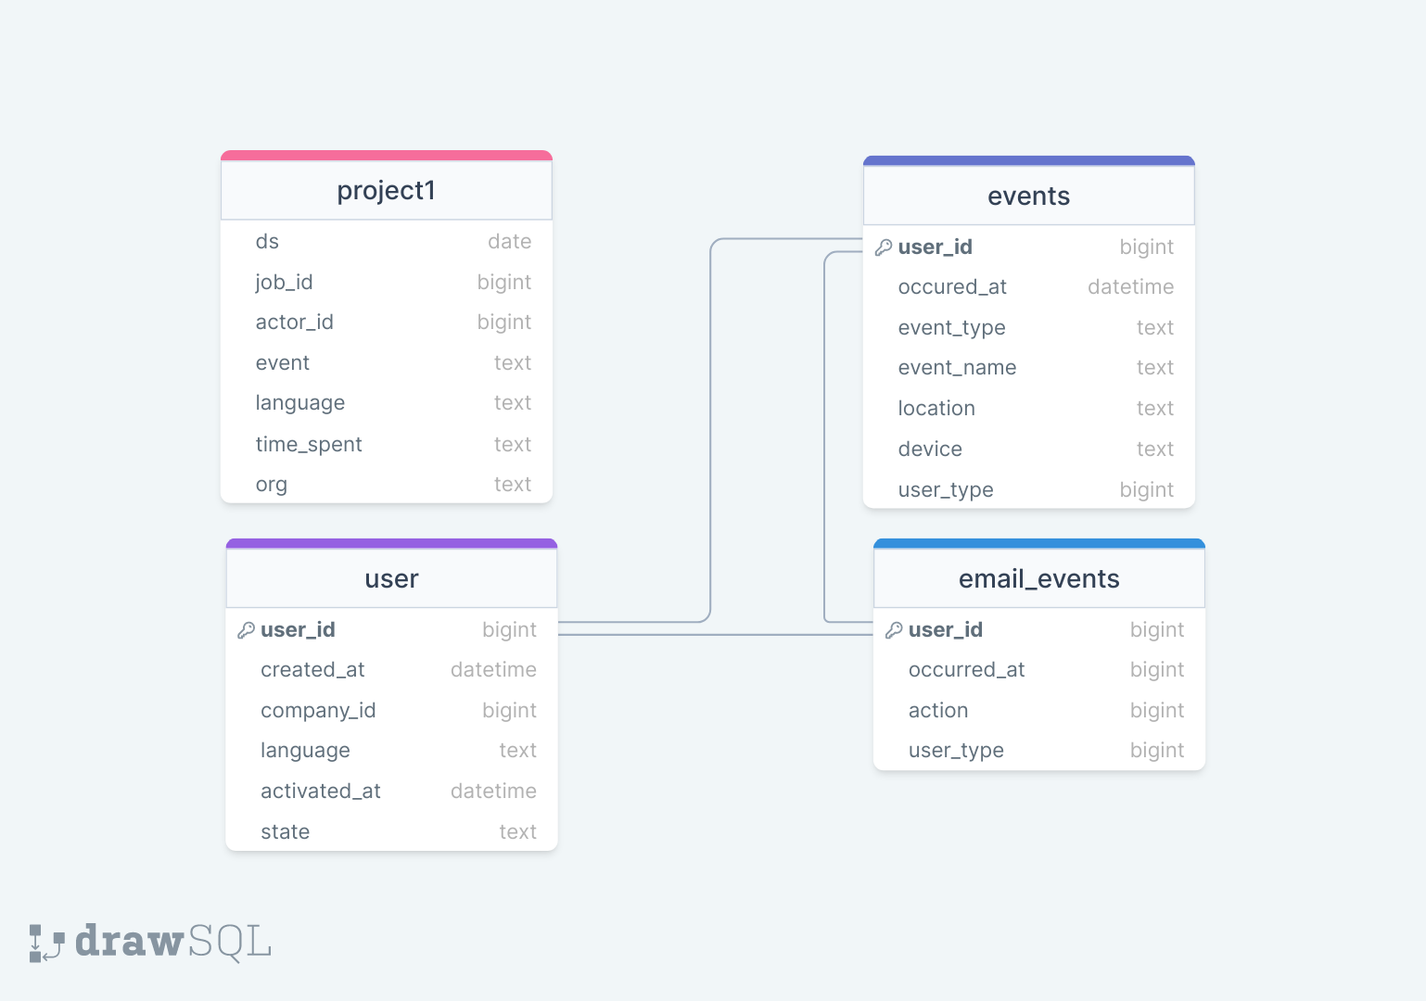
APPROACH
The database consists of four tables with three relational schemas as follows:
SQL queries is used to analyze and derive insights from the data.

Slide 6


TECH-STACK USED:
MySQL 8.0 is used to extract specific data and manipulate the data by using queries to find insights from the dataset.
MySQL Workbench 8.0 CE – To run queries

Slide 7
OPERATION INSIGHTS

Slide 8


CASE STUDY 1 (JOB DATA)
A. Number of jobs reviewed: Amount of jobs reviewed over time. Your task: Calculate the number of jobs reviewed per hour per day for November 2020?
This shows that a very small amount of jobs were reviewed per day per hour, which is just 0.0083.

Slide 9
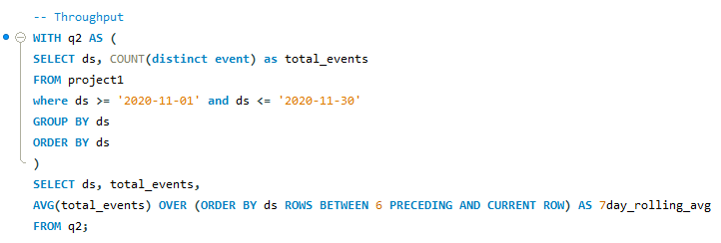
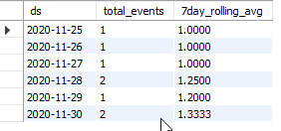
B. Throughput: It is the no. of events happening per second. Your task: Let’s say the above metric is called throughput. Calculate 7 day rolling average of throughput? For throughput, do you prefer daily metric or 7-day rolling and why?
The 7-day rolling average of the events provides an indication the average increased over the week from 1 to 1.33. This shows that there is growth over the week and thus provides a much clearer picture of the overall trend compared to daily metric.

Slide 10
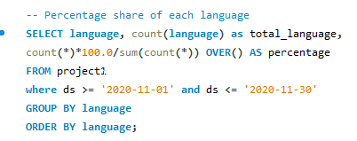
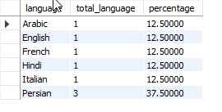
C. Percentage share of each language: Share of each language for different contents. Your task: Calculate the percentage share of each language in the last 30 days?
It turns out to be that Persian language is the most common language among the given languages with a share of 37.5%.

Slide 11
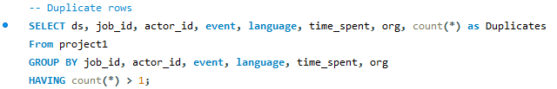
D. Duplicate rows: Rows that have the same value present in them. Your task: Let’s say you see some duplicate rows in the data. How will you display duplicates from the table?
From the results table, it can be seen that there were no duplicates in the data. Thus all the records in the dataset were unique.

Slide 12
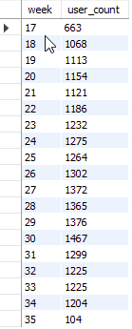
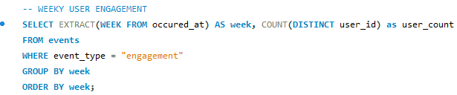
CASE STUDY 2 (INVESTIGATING METRIC SPIKE)
A. User Engagement: To measure the activeness of a user. Measuring if the user finds quality in a product/service. Your task: Calculate the weekly user engagement?
30th week saw the highest user engage of 1467, whereas 35th week saw the lowest user engagement of just 104.

Slide 13
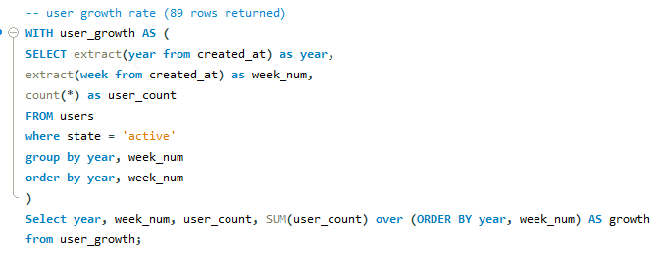
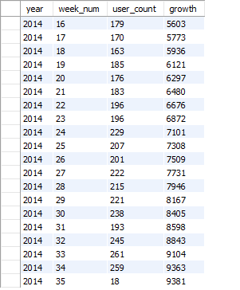
B. User Growth: Amount of users growing over time for a product. Your task: Calculate the user growth for product?
The 33rd week of 2014 saw the highest number of active users, whereas 35th week of 2014 saw the least number of active users engaging with the product/service.
89 rows were returned.

Slide 14
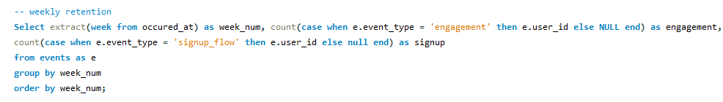
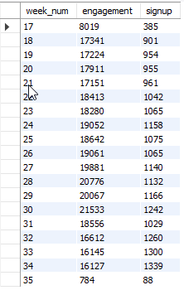
C. Weekly Retention: Users getting retained weekly after signing-up for a product. Your task: Calculate the weekly retention of users-sign up cohort?
19 rows were returned.

Slide 15
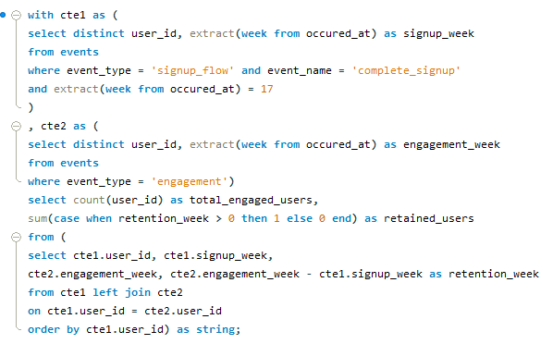

C. Weekly Retention (continued)
In week number 17, 206 users were retained.

Slide 16
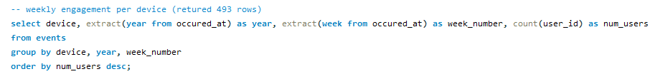
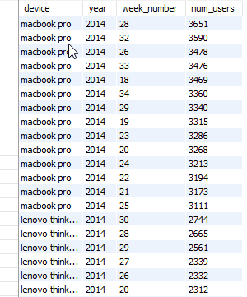
D. Weekly Engagement: To measure the activeness of a user. Measuring if the user finds quality in a product/service weekly. Your task: Calculate the weekly engagement per device?
From the results table, it can be clearly seen that “MacBook pro” device saw the greatest user engagement and thus is the most used device by the users.

Slide 17

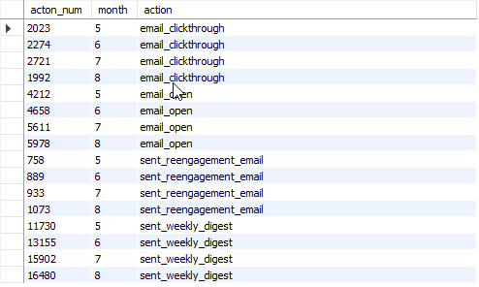
E. Email Engagement: Users engaging with the email service. Your task: Calculate the email engagement metrics?
The month of August saw the highest email engagements by the users.

Slide 18
RESULTS
The number of job reviewed per hour per day is very less i.e. 0.0083.
Persian language came out to be the most common language among the given languages.
The user engage grew continuously till 30th week, the it started to fall down significantly.
The 35th week saw the least engagement by the active users, whereas 33rd week saw the most engagement.
The MacBook pro is the most frequently used device by the users.
The month of August saw the highest email engagements by the users.

Slide 19
FILE LINKS
Project file link: Click Here!
SQL Script file / Working file Link:
Case Study 1 file link: Click Here!
Case Study 2 file link: Click Here!

Slide 20
THANK YOU

